Slide 1
How to Embed Xamarin Forms into Native Apps
Rabeb Othmani
Developer Advocate
@Rabeb_Othmani

Slide 2








Xamarin Forms or Native Apps?

Slide 3





Xamarin Forms or Native Apps?

Slide 4


Xamarin Forms or Native Apps?

Slide 5
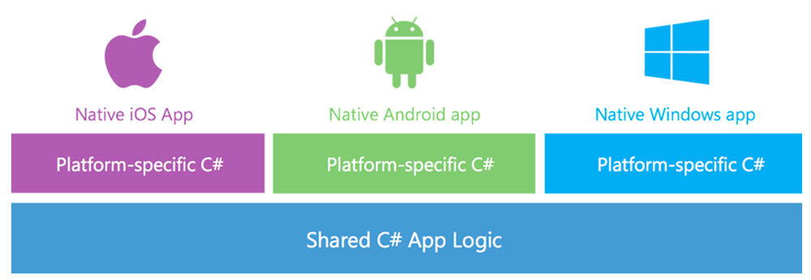
Xamarin Native Apps
Native Look & Feel
Performance
Tons of Native Libraries & Controls

Slide 6
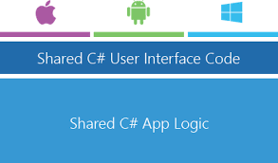
Xamarin Forms
One UI for all platforms
Custom Native Renders
Fast Cross Platform Development process

Slide 7

Why Embedding Xamarin Forms in Native Apps?
Data Binding Anyone?
Does It Really Have To Be Written Three Times?

Slide 8
Embedding Xamarin Forms in Native Apps
You can embed a ContentPage
Xamarin.Forms 3.0 pre-release Nugets
https://www.myget.org/F/xamarinforms-dev/api/v3/index.json

Slide 9

Thank You ☺

